Slide 1
Memory Models and Addresses

Slide 2
Linear Memory Model
In linear memory model the whole memory appears like a single array of data
In earlier processors like 8080 and 8085 the linear memory model was used to access memory
8080 and 8085 could access a total memory of 64K using the 16 lines of their address bus.

Slide 3
Segmented Memory Model
The segmented memory model allows multiple functional windows into the main memory, a code window, a data window etc.
The processor sees code from the code window and data from the data window.
For 16 bit processor the size of one window is restricted to 64K, (16 bit register 2^16=64K)
The four segment registers point to the base of each window.

Slide 4
Physical Addresses
Physical address
00000
64K
FFFFF
Code Segment
As our memory is 1MB, physical addresses are 20 bit long
Every address given in our program will be of 16 bit.
We will need base address of segment and offset calculate physical address in memory.
Each segment start at some address that is multiple of 16.
This is to ensure that the last 4 bits are 0
Now the base address of each segment can be represented using 16 bits (instead of 20)
This is also called Paragraph Boundaries
Following registers hold the (16bit ) base address of each segment.
CS holds the base address of code segment
DS holds the base address of data segment
SS holds the data
ES holds the base of extra segment
Data Segment
Stack Segment
Extra Segment

Slide 5
Logical Address
Physical address
00000
64K
FFFFF
Logical Address
0000
…
0101
….
FFFF
Code Segment
Logical Address Space is the set of all logical addresses generated by CPU for a program
The addresses you have seen in registers so far (e.g IP) are logical addresses.
In 8088 each address we have seen in registers is of 16 bits, so possible logical addresses are 64k
For example
When IP was equal to 0100 it was the logical address of next instruction to be fetched.
When num1 label was 0110 it was logical address starting address of data referred by label num1
Logical address is converted to Physical address to access the data/instruction from memory
Data Segment
Stack Segment
Extra Segment

Slide 6
Calculating Physical Addresses
Physical address
00000
64K
FFFFF
0000
…
0101
….
FFFF
Code Segment
Lets say that IP is 0100h.
This mean the instruction to be fetched is at offset 0100h in code segment.
The 20 bit physical address of this instruction will be calculated by following formula
CS*16 + IP
Here IP is just an offset in Code segment.
Data Segment
Stack Segment
Extra Segment

Slide 7
Calculating Physical Addresses
Physical address
00000
64K
FFFFF
Code Segment
Similarly if you want to access some data with logical address 0131h.
Physically it will be located at
DS*16+ 0131h
Here used DS as base because data is stored in data segment.
Data Segment
Stack Segment
Extra Segment

Slide 8
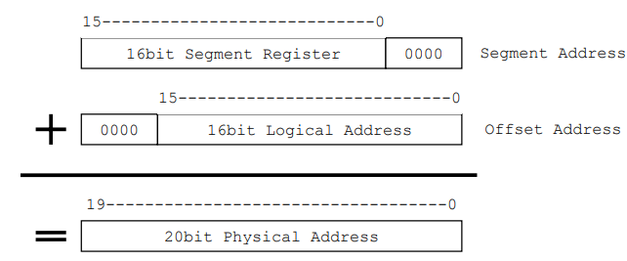
Calculating Physical Address.
The formula to find the 20 bit physical address given segment’s 16 base address and 16 bit offset is
BASE *16 + OFFSET
This can be seen in figure as

Slide 9
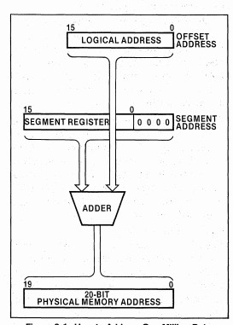
Another figure

Slide 10
Calculating Physical Address.
Example 1:
If IP=0103h and CS=0200h then what is the physical address of the instruction to be fetched?
Solution:
02000h+00103h =02103h
The same calculation can be done in binary
0000 0010 0000 0000 0000 + 0000 0000 0001 0000 0011 = 0000 0010 0010 0000 0010
Example 2:
If a label named num1 has logical address of FFA0h in data segment and DS register is equal to 1BAA then what is the physical address of num1?
Solution:
1BAA0h + 0FFA0h = 2BA40h
The same calculation can be don in binary
‭0001 1011 1010 1010‬ 0000 + 0000 1111 1111 1010 0000= ‭0010 1011 1010 0100 0000‬
Notes:
IP =0103h CS=0200h

Slide 11
Calculating Physical Address.
Example 3:
If a BX logical address of FFA0h stored in it and DS register is equal to 1BAA the which physical address will be used on following statement
Mov ax, [bx+1]?
Solution:
1BAA0h + 0FFA1h = 2BA41h
The same calculation can be don in binary
‭0001 1011 1010 1010‬ 0000 + 0000 1111 1111 1010 0001 = ‭00101011101001000001‬

Slide 12
Calculating Physical Address.
Note that all these calculation to find physical address will be done by processor.
The programmers can work with logical addresses.
For example when you write
mov [num1+10], ax
Programmer is just telling the logical address to processor
Physical location in memory will be calculated by processor.

Slide 13
Overlapping Segments
Consider if data segment starts from 01000 and code segment starts from 01010, and both are 64k long, then both segments will overlap. As shown in figure.
It is possible to produce same physical address using different combination of segment base and offset as shown in next example.
Code Segment
Data Segment

Slide 14
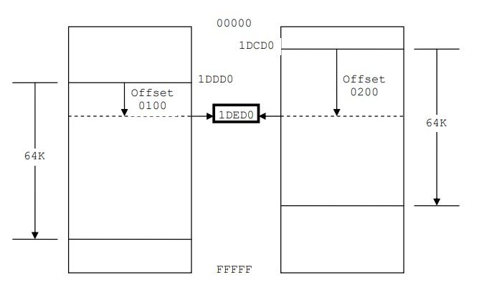
Overlapping Segments
The base address of two segments shown in figure are 1DDD0 and 1DCD0 resp.
Same physical address will be access if offset of 0100 is used with 1DDD0 (also written as 1DDD:0100) and offset 0200 with 1DCD (IDCD:0200)

Slide 15
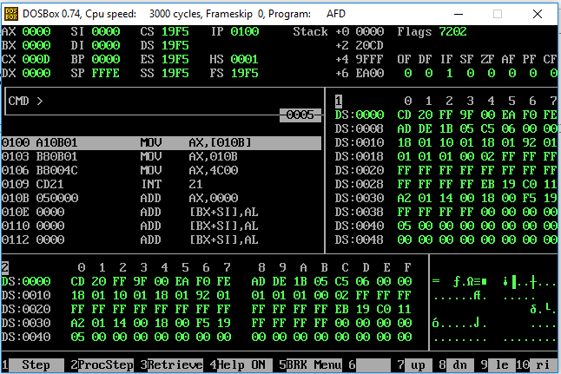
In AFD
Segment base addresses, note that all of these are same, so all segments here overlap
Logical addresses of data segment

Slide 16

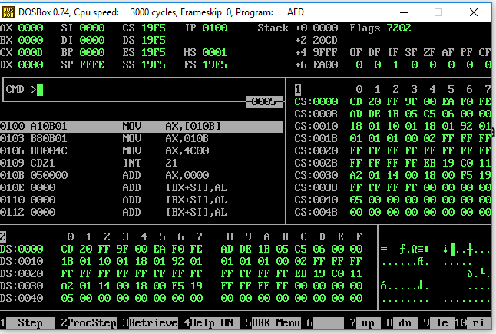
In AFD
You can view other segments in AFD by using following command
code segment

Slide 17
Segment Association
There is a default segment associated to every register which accesses memory.
Note that in example 1 on slide 3, CS was used as base to find physical address, so CS is associated to IP by default ( unchangeable)
In example 3, DS was used as base to calculate physical address. So BX is associate with DS by default. Can be changed
The list of all these associations is given in next slide

Slide 18
Segment Association
To override the association for one instruction of one of the registers BX, BP, SI or DI, we use the segment override prefix. For example “mov ax, [cs:bx]” associates BX with CS for this one instruction. For the next instruction the default association will come back to act.
Register | Default associated segment | Flexible
BX, SI, DI | DS | yes
IP | CS | No
BP | SS | Yes
SP | SS | No

Slide 19
ADDRESS WRAPAROUND
Memory is like a circle, if you start from 0000 an keep on going to next byte by adding 1 then on reaching FFFF adding 1 will take you again to 0000.
This happens because when adding offset in address, if carry is generated it is dropped.
Wraparound occurs in while calculating effective as well as physical address. Examples are given in next slide

Slide 20
ADDRESS WRAPAROUND Example
Effective address:
If bx= FFFE then [bx+0003h] will result in effective logical address is 0001. Note that FFFE+0003=1 0001 so carry 1 is dropped and addresses was wrapped around within a segment.
Physical address:
If BX=0100h (some logical address in Data Segment), DS=FFF0h (base address of data segment)
Then physical address generate by [bx+0x0100] will be FFF00+(0100+0100)=00100
Note that the effective address is calculate before physical address.
Note that the carry was dropped and physical address was wrapped around.

Slide 21
Flag Register with Examples

Slide 22
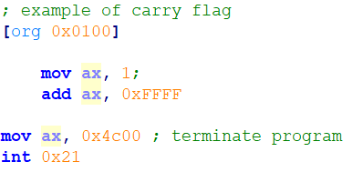
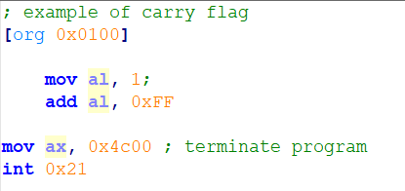
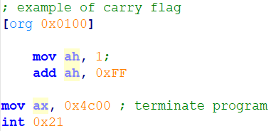
Carry Flag
When two 16bit numbers are added the answer can be 17 bits long or when two 8bit numbers are added the answer can be 9 bits long. This extra bit that won’t fit in the target register is placed in the carry flag where it can be used and tested.
Examples: in all of the following examples CF should be 1 after addition

Slide 23
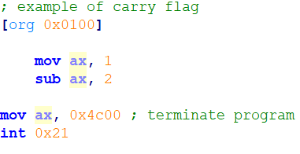
Carry Flag
The carry flag plays the role of borrow during the subtraction operation. And in this condition the carry flag will be set.
Example: in following example carry flag will be set as 1

Slide 24
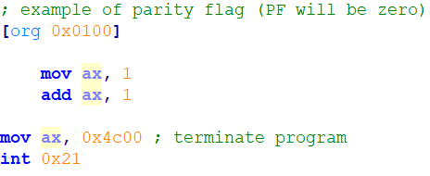
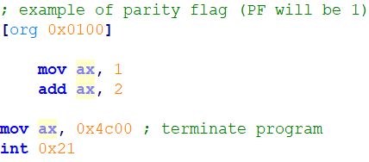
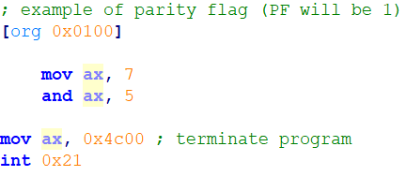
Parity Flag
Parity flag indicates if the numbers of set bits is odd or even in the binary representation of the result of the last operation.
It is only effected by arithmetic and logical operations.
This information is normally used in communications to verify the integrity of data sent from the sender to the receiver.

Slide 25
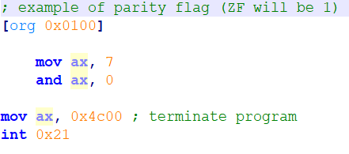
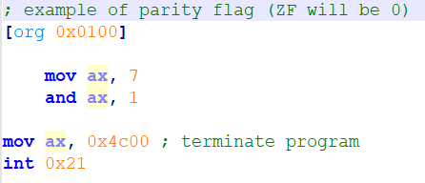
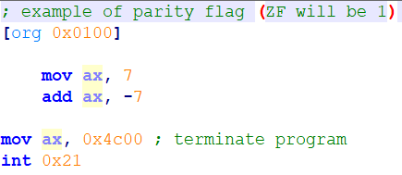
Zero Flag
The Zero flag is set if the last mathematical or logical instruction has produced a zero in its destination.
Note the values of -7 in afd or listing file

Slide 26
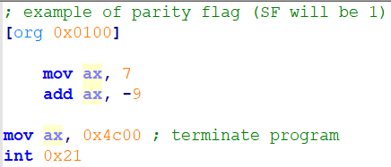
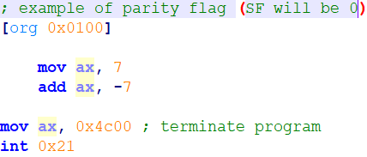
Sign Flag
A signed number is represented in its two’s complement form in the computer.
The most significant bit (MSB) of a negative number in this representation is 1 and for a positive number it is zero.
The sign bit of the last mathematical or logical operation’s destination is copied into the sign flag.

Slide 27
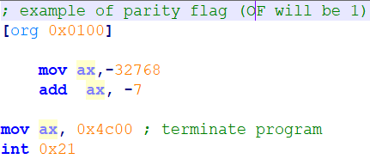
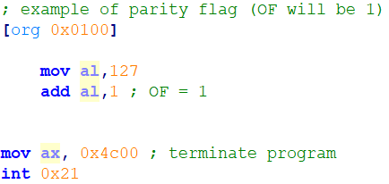
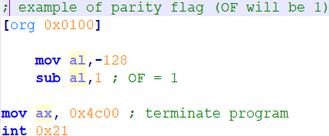
Overflow flag
Set when the result of a signed arithmetic operation is too large or too small to fit into the destination.
Example 1, if an instruction has a 16- bit destination operand but it generates a negative result smaller than -32,768 decimal, the Overflow flag is set.
Example 2, we know that the largest possible integer signed byte value is 127; adding 1 to it causes overflow:
Example 3: Similarly, the smallest possible negative integer byte value is 128. Subtracting 1 from it causes underflow. The destination operand value does not hold a valid arithmetic result, and the Overflow flag is set.
Notes:
Examples:
-1 -128
-125 -126
125 +126
127
[org 0x0100]
mov al ,10001111b
mov bl , 10001000b
add al,bl
mov ax, 0x4c00
int 0x21

Slide 28
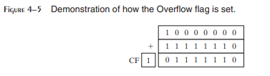
How the Hardware Detects Overflow
The CPU uses an interesting mechanism to determine the state of the Overflow flag after an addition or subtraction operation.
The value that carries out of the highest bit position is exclusive ORed with the carry into the high bit of the result.
The resulting value is placed in the Overflow flag.
In Figure 4-5, shows that adding the 8-bit binary integers 10000000 and 11111110 produces CF = 1, with carryIn(bit7) = 0. In other words, 1 XOR 0 produces OF = 1.
Reference KI

Slide 29
Trick to know value of OF
Another indication to see the OF will be set is when the MSB of the destination first operand is not same as result.
Ex
0000 0001 - 1111 1111 = 0000 0010
OF= 0
0000 0001 + 0111 1111 = 1000 0000
OF=1

Slide 30
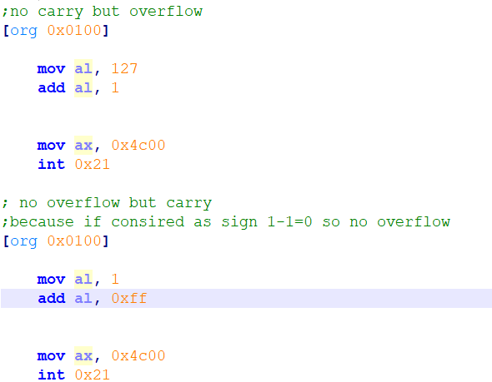
More examples

